Slide 1
LEARNING OBJECTIVES
Define the elements of perception and their role in consumer behavior.
• Know how consumers organize stimuli to form perceptions.
• Define sensory adaptation and its impact on marketing.
• Identify why and how consumers “add” biases to stimuli and the
implications for marketers.

Slide 2
PERCEPTION IS REALITY
Perception is the process by which individuals select, organize
and interpret stimuli into a meaningful and coherent picture of the world.

Slide 3
INPUTS INTO PERCEPTION
Physical stimuli from the outside environment
People’s expectations and motives based on past experiences
A stimulus is any unit of input to any of the senses.
That means a stimulus could be anything from a product
to a marketing message to a car honking on the street

Slide 4
INDIVIDUAL IMPACT
The combination of the two very different kinds of inputs
that combine to create a consumers’ perceptions (physical stimuli from the outside environment and people’s expectations and motives based on past experiences) produces a very private, very personal picture of the world.

Slide 5
HOW CONSUMERS ORGANIZE STIMULI
PRINCIPLES OF GESTALT PSYCHOLOGY
• Similarity
• Closure
• Proximity
• Figure and Ground

Slide 6


PRINCIPLES OF GESTALT PSYCHOLOGY: SIMILARITY

Slide 7
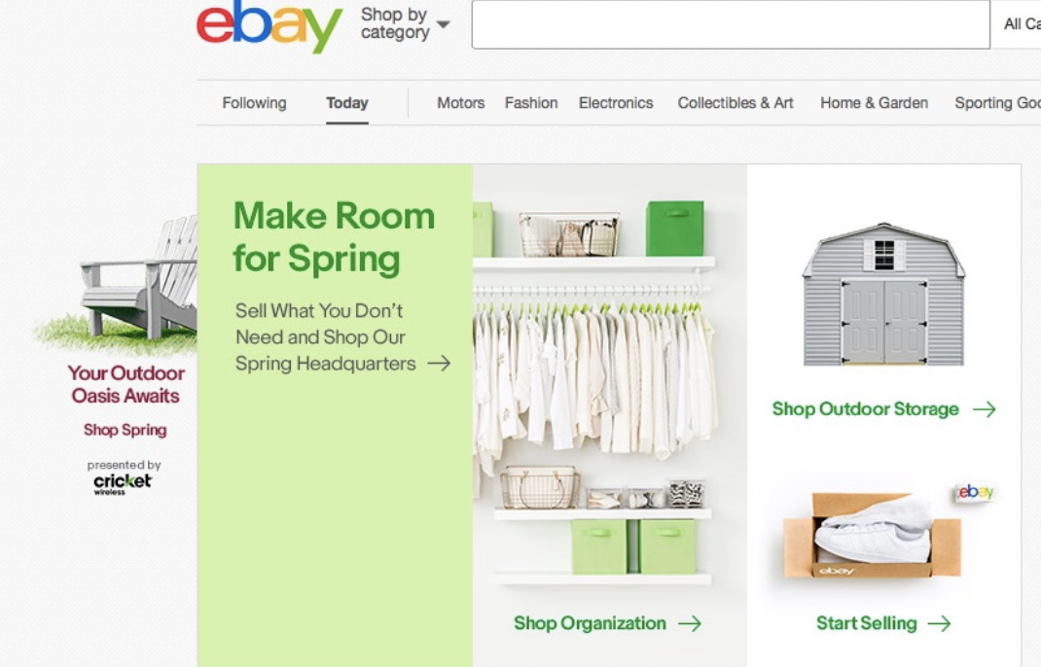
PRINCIPLES OF GESTALT PSYCHOLOGY: SIMPLICITY

Slide 8

PRINCIPLES OF GESTALT PSYCHOLOGY: CLOSURE

Slide 9

PRINCIPLES OF GESTALT PSYCHOLOGY:
FIGURE AND GROUND

Slide 10


Examples of Brands that use Figure and Ground Principle

Slide 11

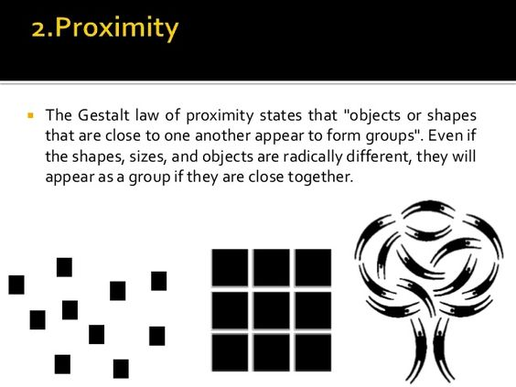
PRINCIPLES OF GESTALT PSYCHOLOGY: PROXIMITY

Slide 12

Example of Brand that uses Principle of Proximity

Slide 13
SENSORY ADAPTATION
Sensory adaptation is essentially “getting used to” or being less
able to notice certain sensations in the environment around you
Application for marketers:
Updating marketing campaigns frequently
Creating marketing campaigns that appeal to multiple sensory receptors (Smell, Sound, Taste)

Slide 14

AMBUSH MARKETING
Ambush marketing is the practice of placing ads in places where consumers don’t expect to see them or where they simply can’t avoid them.

Slide 15
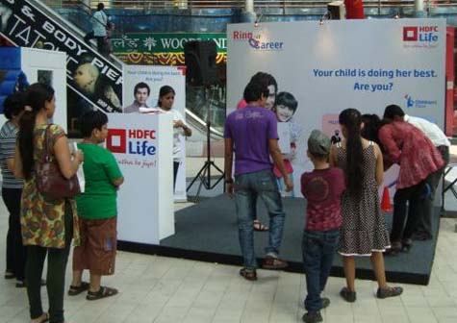
EXPERIENTIAL MARKETING
Experiential marketing allows customers to engage with
and interact with brands, products and services in ways
that appeal to multiple senses and often create emotional
bonds between consumers and companies.

Slide 16
FOR SENSORY CAMPAIGN DEVELOPMENT
Create memorable content and campaigns relevant to customers.
Consider partnering with creators appealing to your target customer
(e.g., artists, other brands, musicians) especially if they have strong
brand awareness in an area where your company is trying to grow.
Don’t try too hard! Create experiences and advertisements that
are truly authentic to your brand identity and voice.

Slide 17
Exposure
Consumer comes into physical contact with a stimulus
Marketing stimuli: Information about offerings communicated by the marketer or by nonmarketing sources
Factors of influence
  Position of an ad within a medium
  Product distribution
  Shelf placement

Slide 18
Selective Exposure
Zipping: Fast-forwarding through commercials on a program recorded earlier
Zapping: Switching channels during commercial breaks
Cord-cutting - Choosing streaming services over cable television

Slide 19
Attention
Amount of mental activity a consumer devotes to a stimulus
Enables consumer to learn efficiently from their exposure to marketing stimuli
Limited, selective, and divisible
Defines customer segments
Weakened by habituation
Under what conditions do you give full attention to advertising and marketing communication?

Slide 20
Focal and Nonfocal Attention
Focal attention - Consumers focus on a stimulus
Nonfocal attention - Consumers are simultaneously exposed to other stimuli
Preattentive processing: Non-conscious processing of stimuli
  Leads to liking a brand name

Slide 21
Perception
Determining the properties of stimuli using vision, hearing, taste, smell, and touch
Factors in visual perception
  Size and shape
  Lettering
  Image location on package
  Color
  Appearance of being new or worn

Slide 22
Perception (continued 1)
Taste
  Varying perceptions of food
  Different cultural backgrounds influence taste preference
  In-store marketing tactic of tasting or sampling of food
Elements in sound perception
  Sonic identity - Use of specific sounds to identify a brand
  Sound symbolism - Inference of product attributes and evaluations
    Using information obtained from hearing a brand’s sounds, syllables, and words

Slide 23
Perception (continued 2)
Touch
  Liking of some products because of their feel
  Perceived ownership of the item increases
  Consumer reaction to touch differs across cultures
Smell
  Effect on physiological responses, liking, product trial, and buying

Slide 24
WHY AND HOW CONSUMERS “ADD” BIASES
STEREOTYPES
Often, individuals carry biased pictures in their minds of the meanings
of various stimuli—these biased pictures are called stereotypes.
Just how are stereotypes formed in the minds of consumers?
Sometimes, when presented with sensory stimuli, people “add” these biases to what they see or hear and thus form distorted impressions
of the stimuli around them.

